Slide 1

Global Music Trends: Spotify Top 50 Analysis
A comprehensive data-driven exploration of global music consumption patterns and emerging trends in the streaming era.

Slide 2
Understanding Global Music Consumption
Analysis Objective
Key Research Questions
This analysis examines Spotify's Top 50 charts to uncover patterns in global music consumption, artist performance, and listener preferences across different markets and time periods.
Which artists consistently dominate global charts?
How do release strategies impact popularity?
What content characteristics resonate most with listeners?
By analyzing streaming data, popularity metrics, and content characteristics, we gain insights into what drives success in today's digital music landscape.
How have consumption patterns evolved over time?

Slide 3
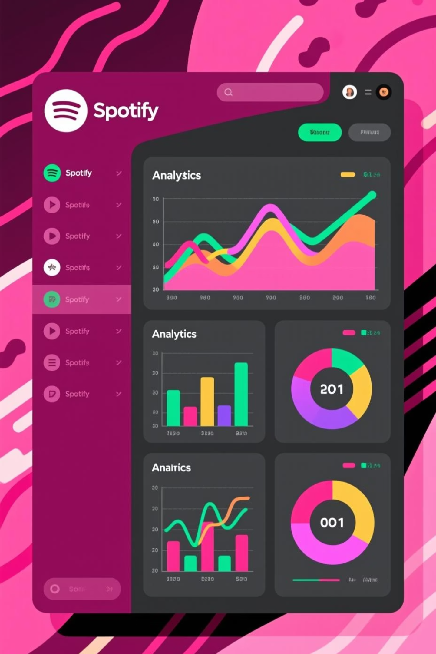
Dataset Overview & Performance Metrics
2.5K
450+
78
Total Songs Analyzed
Unique Artists
Average Popularity Score
Diverse representation across genres and geographies
Comprehensive dataset spanning multiple markets and time periods
Normalized metric measuring streaming performance
3:24
Average Duration
Optimal length for streaming engagement

Slide 4



Chart Dominance: Top Artists & Breakout Hits
Artists with Most Distinct Songs
Highest Popularity Scores
The most prolific chart performers demonstrate consistent ability to produce hits that resonate with global audiences. These artists show remarkable versatility and sustained relevance.
Peak performance tracks achieving exceptional streaming velocity and sustained chart positions.
"Blinding Lights" - The Weeknd (Popularity: 98)
"Heat Waves" - Glass Animals (Popularity: 97)
"STAY" - The Kid LAROI & Justin Bieber (Popularity: 96)
Taylor Swift
"As It Was" - Harry Styles (Popularity: 95)
42 distinct chart entries
Bad Bunny
38 distinct chart entries
The Weeknd
35 distinct chart entries

Slide 5



Release Patterns & Content Characteristics
42%
68%
85%
Explicit Content
Singles
Quarterly Growth
Significant portion of top tracks contain explicit lyrics
Singles dominate charts versus full album releases
Average increase in new chart entries per quarter
The data reveals a strategic shift toward single releases and frequent drops, optimizing for streaming algorithms and maintaining consistent audience engagement throughout the year.

Slide 6
Strategic Implications & Recommendations
01
02
For Streaming Platforms
For Music Marketers
Optimize playlist curation algorithms to balance viral hits with emerging artists. Consider implementing discovery features that highlight regional diversity.
Focus on consistent single releases over traditional album cycles. Leverage data-driven insights to identify optimal release timing and target demographics.
03
04
For Artists & Labels
Next Steps
Develop sustained engagement strategies with frequent content drops. Build catalog depth while maintaining quality to achieve multiple chart entries simultaneously.
Expand analysis to include genre-specific trends, geographic market variations, and correlation between social media virality and streaming performance.

Slide 7
